Slide 1

Notifier Service

Slide 2








Features
…

Slide 3


Dependencies
Node.js
YARN or NPM
express
body-parser
node-notifier

Slide 4
endpoints
{}
GET /health
{}
POST /notify

Slide 5
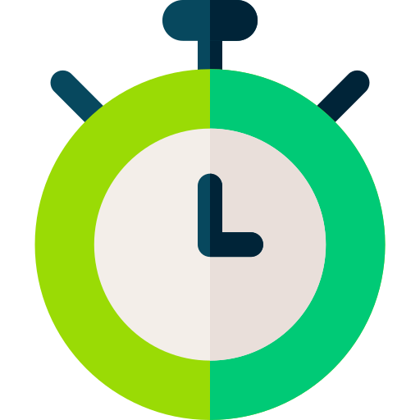


http timeout
REQUEST
RESPONSE
{}
15s
{}

Slide 6
http response
{
"deliveredAt": "2020-01-09 13:11:56 +0200",
"activationType": "closed",
"activationAt": "2020-01-09 13:11:58 +0200",
"activationValue": "Completed?"
}

